Slide 1
Final Exam Presentation
By: Jacob Aylward

Slide 2
Data Modifications
Before determining the questions to be answered with the data some modifications were made
The data used to answer the questions is a sample data of 2% of the full data (per instructions)
Variables consisting mainly of “null” values were deleted for this new data section
Variables deleted: "mercury_content_ppm","natural_gas_delivery_contract_type_code","moisture_content_pct","chlorine_content_ppm","mine_id_msha”
A random 4-digit number as the seed was used to sample the data to ensure uniqueness (set.seed(1738)) (per instructions)

Slide 3
Objectives With The Data
The overall objectives with this data is to determine whether relationships between certain variables will support the amount of each fuel type used
First the usage of each fuel type will be recorded
Find the average value of each fuel type used to determine if it supports which type is most commonly used
Lastly, a comparison using cluster analysis between fuel_received_units and fuel_mmbtu_per_unit will be found to determine if the clusters can show where each fuel type may be based on usage

Slide 4
Objectives With The Data
With the given data the questions decided upon are listed below:
From the 2% sample of data what is the most common fuel type used?
Does the average amount of fuel received units for each type support the kind that is most commonly used? If not what are some assumptions that can be made?
What are the clusters like for fuel_received_units and fuel_mmbtu_per_unit and what can this tell us based on the units received and fuel in each unit?

Slide 5
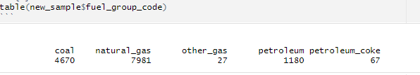
Question 1
From the 2% sample of data what is the most common fuel type used?
From the data sample we see natural gas is most commonly used fuel type by a large margin

Slide 6
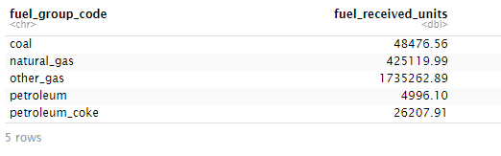
Question 2
Does the average amount of fuel received units for each type support the kind that is most commonly used? If not what are some assumptions that can be made?

Slide 7
Question 2: Results
The average for fuel units received does not support that natural gas is the most commonly used. Why is this?
Despite natural gas not being the fuel most received on average per unit this could be due to the values of “fuel_mmbtu_per_unit” having a range of differences
Question 3 will show a cluster analysis to show why “other gases” may be the most on average received

Slide 8
Question 3
What are the clusters like for fuel_received_units and fuel_mmbtu_per_unit and what can this tell us based on the units received and fuel in each unit?
Finding clusters based on fuel_received_units and fuel_mmbtu_per_unit
(units received and fuel in each unit)
The number of clusters is determined based on k-means

Slide 9
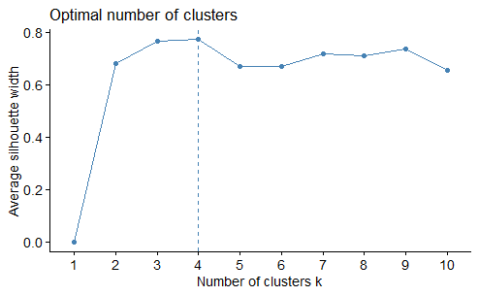
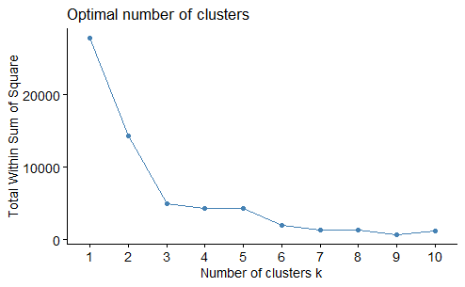
Question 3
Used both the “silhouette” and “wss” methods to find the optimal number of clusters

Slide 10
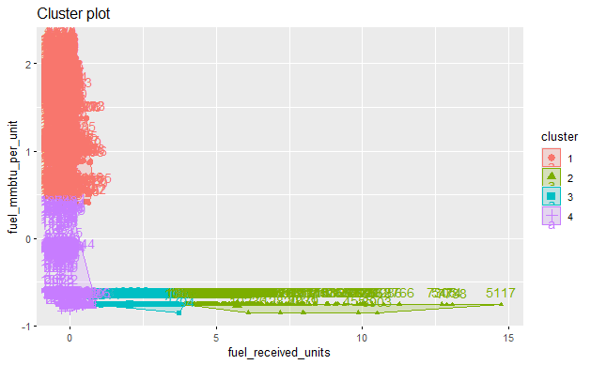
Question 3
Based on the graphs shown it was determined that the optimal numbers of cluster is k = 4
Amount of units in
each cluster

Slide 11
Question 3: Results
Cluster 1 represents fuel orders received that have the most fuel per unit based on the units received indicating that the most value may be gained from orders within this cluster.
Cluster 2 represents a large variety of fuel units ordered but with a common variable of being below positive value in terms of the fuel received in each unit. Specifically, fuel received units of 10 or more have very little value gained in terms of fuel per unit indicating that the overall cost paid for the units is not likely to be worth the value.
Cluster 3 represents fuel units received with the worst value of fuel per unit based on the units received. By having a limited amount of fuel per unit with minimal units being ordered there is not much value gained per unit.
Cluster 4 represents a mixed value of fuel per unit with small amounts of units received. For any orders that have a positive value for fuel received per unit likely gains value due to small amount of units ordered but any orders with a negative value for fuel do not gain much value.

Slide 12
Question 3: Results
From these cluster results and the amount of units in each cluster some assumptions can be made:
“Other Gases” likely has many units within Cluster 2 due to being the most units received on average but being the lowest form of fuel used. Due to Cluster 2 having many negative values of fuel per unit it likely means more units are needed per order to meet demand leading to having the highest average
Petroleum may have many orders in Cluster 1 due to being the lowest units received on average but being the 3rd most used fuel form. Meaning the orders that are created have positive value of fuel per unit leading to less units being needed.
Natural Gas likely has many orders in Cluster 4 and a good portion of Cluster 1 to support being the most used fuel form but also having the 2nd highest units received on average. Meaning more value of fuel per unit is gained in some orders compared to others.

Slide 13
Resources
Out_eia923__fuel_receipts_costs-2.csv : In Canvas
Wu, CJ. (2025, June). “Implementation of K-Means Clustering In R ” [Lecture Recording]. Canvas,[https://kent.instructure.com/courses/112894/pages/view-k-means-implementation-2-56-minutes?module_item_id=5303325]
Wu, CJ. (2025, June). “, DBSCAN Versus K-Means” [Lecture Recording]. Canvas, [Link:https://kent.instructure.com/courses/112894/pages/view-dbscan-k-means-4-30-minutes?module_item_id=5303334]

